Slide 1

Hash Collisions and
The Birthday Paradox
By Connor Ferguson

Slide 2

Hash Functions in Review
Deterministic
Each input has the same output.
Fixed Output Size
The size of the input doesn’t effect the size of the output.
Ideally Fast to Compute
You can quickly generate a hash with input.
Nonreversible, “One Way”
It is hard to find the input if you only have the output.
SHA256: “abc”
ba7816bf8f01cfea414140de5dae2223b00361a396177a9cb410ff61f20015ad
SHA256: “Abc”
06d90109c8cce34ec0c776950465421e176f08b831a938b3c6e76cb7bee8790b
SHA256: “Professor Yuen”
4f7eb0cfdf657bde429b691539ad6d425d0da17007117c669e49f1b20b39f405

Slide 3

Collision Resistance
What are collisions? Can they be avoided?
There exists an “infinite” number of inputs, but a finite number of hash outputs
Therefore the pigeonhole principle tells us…
We’ll find two unique x and y, such that H(x) = H(y)
Preimage Resistance
For a desired y, it is hard to find x, such that H(x) = y
You have the hash output, find the input.
Weak Collision Resistance
Given an x and that x != y, it is hard to find y, such that H(x) = H(y).
You have the input and its hash, find another input with the same hash.
Strong Collision Resistance
It is hard to find any pair (x, y), such that H(x) = H(y)
Find any two random inputs with the same hash.

Slide 4
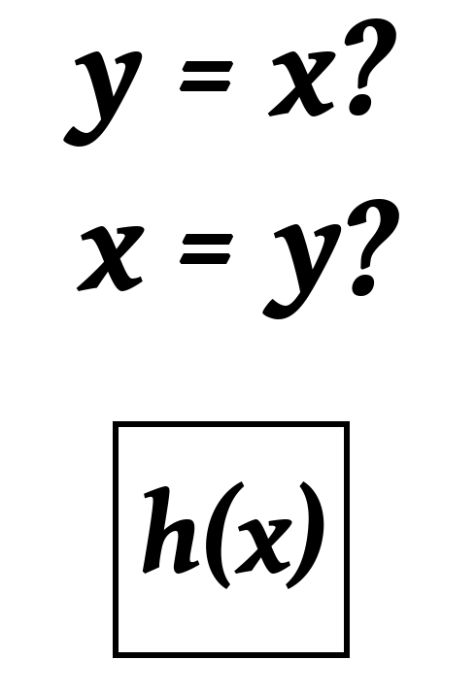
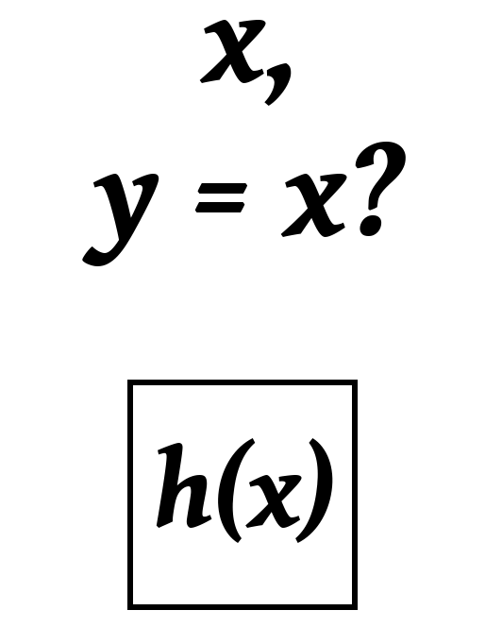
Weak and Strong Collision Resistance
Strong vs Weak Collision Resistance
Weak: we have only a single dynamic input
Strong: Either input can change, wider net
If a weak collision can be made in N guesses...
... a strong collision can be made in √N guesses
Strong collision resistance is harder to achieve
Strong Collision Resistance implies Weak Resistance
Collision Resistance is a temporary quality
MD5 and SHA-1 were considered collision resistant and cryptographically secure at one point
Both have been broken now - https://shattered.io/
SHA-2 is expected to be broken in near future, but SHA-256 and SHA-512 are likely to be safe for a very long time

Slide 5
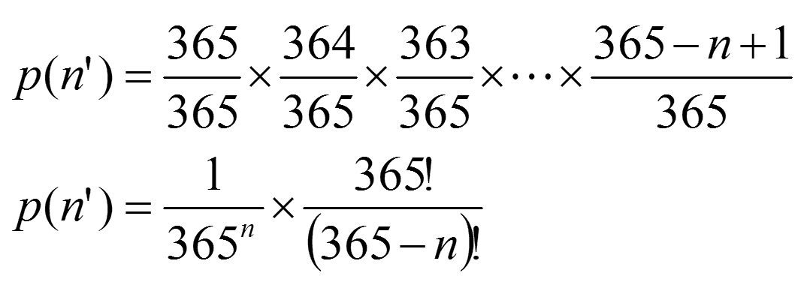
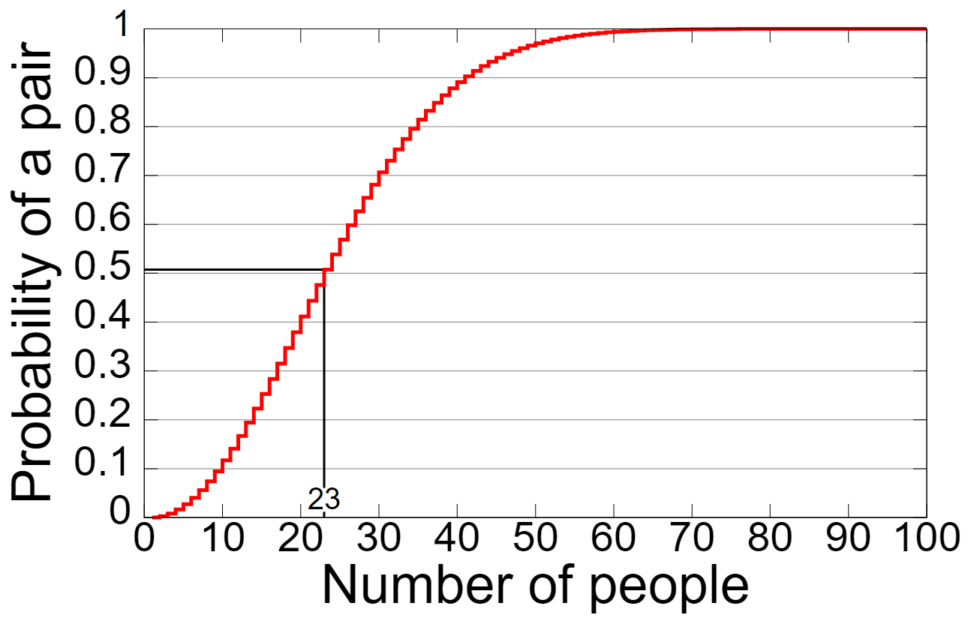
The Birthday Paradox
Given “n” people, what’s the likelihood that two people have the same birthday?
The probability grows unexpectedly fast!
If n = 5, P(n) = 2.7%
If n = 23, P(n) =50.7%
If n = 70, P(n) = 99.9%
This problem models hash collisions very well!
Matches with strong collision resistance
MD5 (128 bits): P(2.2×10¹⁹) = 50%
SHA256: P(4.0 × 10³⁸) = 50%
SHA512: P(1.4 × 10⁷⁷) = 50%

Slide 6
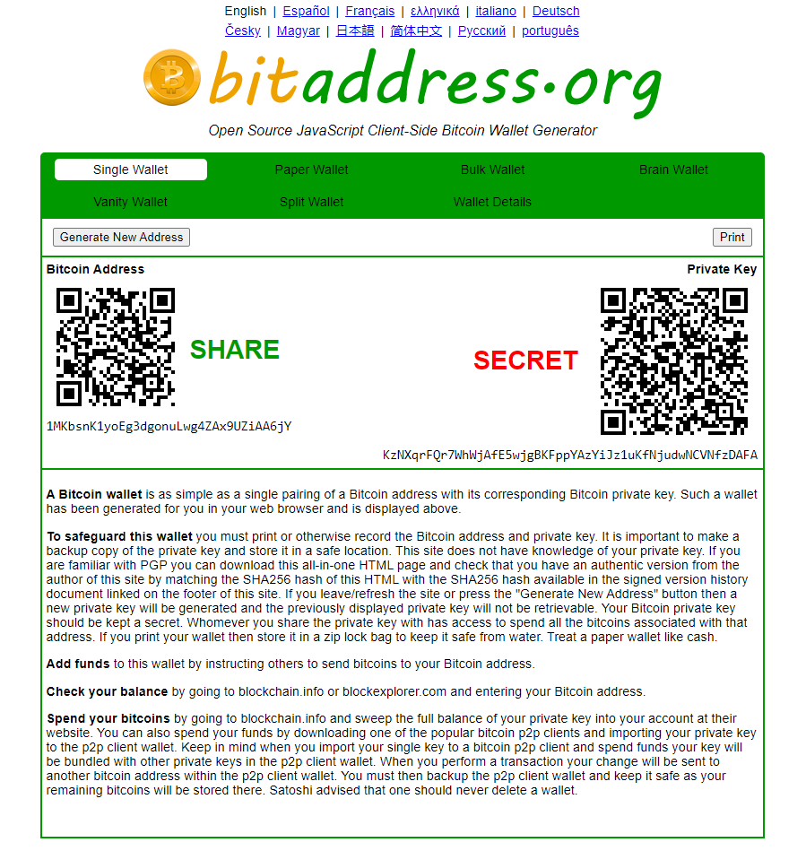
Cryptocurrency Addresses
What is a bitcoin wallet?
Each wallet has a public and private key
The public key allows you to receive funds
The private key allows you to send funds
How are wallets made?
In theory, there are 2²⁵⁶ possible wallets.
Simply put, each wallet is one of those numbers.
You can even make a wallet here - https://www.bitaddress.org/
Can someone guess my private key?
In theory, yes.
The only real protection is the immense number of possible keys.
Is randomly guessing keys worth the trouble?

Slide 7

Collisions in a Cryptocurrency Environment
The Worst Case Scenario
There will only ever exist 21 million bitcoin
A satoshi is equal to 1x10⁻⁸ bitcoin
Therefore there will be 21x10¹⁴ satoshis at most
If each wallet has 1 satoshi, that’s 21x10¹⁴ wallets
The total number of possible keys is 2²⁵⁶
Our odds of finding the right address is 1.8x10⁻⁶²
The Real Life Scenario
60~75 million estimated wallets ever used
Many of these are likely empty
Our odds of hitting any wallet here is 6.1x10⁻⁷¹
In Review
A bitcoin wallet is kind of like hiding money by burying it
In theory, anyone could guess the right place to dig it up
However, as we saw the odds of doing this a immensely low
It would actually be smarter to go digging for money in real life

Slide 8

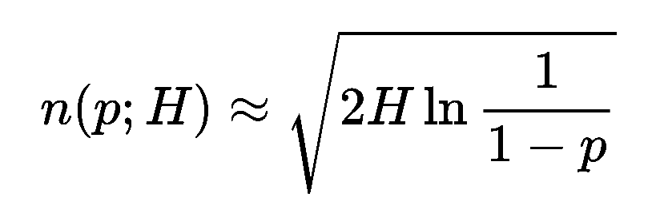
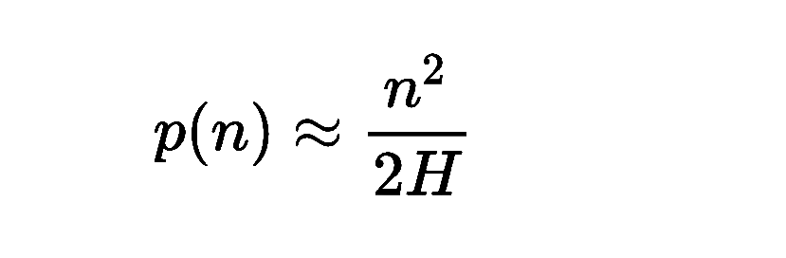
Coding Example Activity
BirthdayParty(int n)
Throws a party with n people attending
Shows you all of their birthdays and if any two people have the same birthdays
BirthdayProbability(int n, int k)
Finds likelihood of collision
n potential options, k choices
Convenient for most of our needs
Simple, fast to execute
HashCollision(long p, long h)
Tells us number of guesses needed for a desired probability of collision
2^{H} potential hashes, 10^{p} desired probability
Includes full equation and an estimate equation
Loss of accuracy for some very large numbers

